Slide 1
Virpara Riddhi, Luhar Kiran, Mistry Rinku, Garoda Dharmistha
Presents….

Slide 2
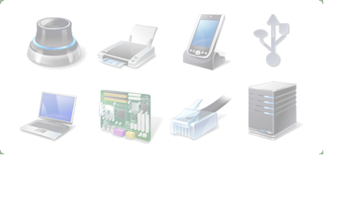
Hardware and Software
Computer system comprises hardware and software

Slide 3
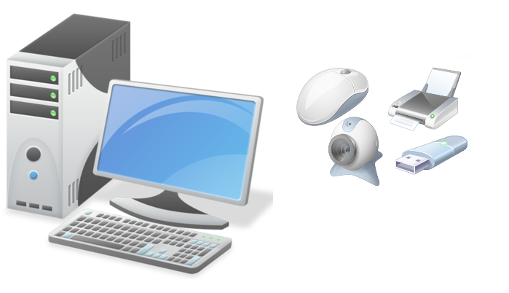
Hardware
The Physical parts of a computer are called hardware. User can touch, see and feel the hardware. It consists of electronic circuits board, processors and mechanical equipment etc. used to perform various functions in the computer. For Example.
Circuit Boards
Processors
Keyboard
Printers

Slide 4
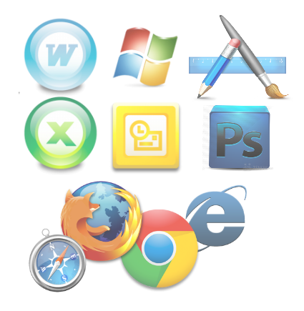
Software
A sequence of instruction given to a computer to perform a particular task is called program and a set of programs written for a computer is called software. One can also say that software is set of instructions given by user to the computer and tells the computer what to do and how to do the given task. For example.
Operating System
Editor
Compilers
Java-Programming language

Slide 5
Application Software and System Software
Application Software
Application software are user written applications and user defined programs.
In application software the functions and instruction are written by user.
Application software makes the system software to do work.
Application software includes MS power point, word, excel, games etc.
System Software
System software includes all the programs and software designed by the manufactures to run the system.
In the system software instructions are pre-coded by the manufactures.
System software makes the physical machine do work.
System software includes, Windows, Mac, Oracle, Unix etc.

